Slide 1
Data Mining in Twitter Proof of Concept Demonstration
September 28, 2015
Kevin A. Ryan
National Security Analysis Department
Email: kevin.ryan@jhuapl.edu | Phone: 240-228-6419

Slide 2
Purpose of this Presentation
Demonstrate NSAD capability in the Social Media Analysis and Data Mining space:
Leverage accepted processes
Use Twitter as source data
Leverage open source (and free) software tools
Develop insightful
Examine simple study question with applicability to wide variety of sponsors
Using only data from Twitter, what were the prevailing narratives for the presidential candidates Trump and Clinton?

Slide 3
Overview Data Mining Process
What is Data Mining?
Data mining is the process to discover interesting knowledge from large amounts of data [Han and Kamber, 2000].
It is an interdisciplinary field with contributions from many areas, such as statistics, machine learning, information retrieval, pattern recognition and bioinformatics.
The main techniques for data mining include classification and prediction, clustering, outlier detection, association rules, sequence analysis, time series analysis and text mining, and also some new techniques such as social network analysis and sentiment analysis.
How do you do it?
Retrieval
Transforming
Stemming
Relationships
Frequencies
Analytics
Twitter API
Data structure of tweets
Query structure
Conversion to data frame
Build a corpus
Eliminate extra characters
Scan all tweets to identify what terms are present
Creating a single term from multiples
Example: “update", “updated" and “updating" would all be stemmed to “updat“
Identify relationship between terms and tweets,
Build matrix with each row stands for a term and each column for a tweet, and an entry is the number of occurrences of term in the tweet
Identify the most common terms and the most common combination of terms.
Frequency Plots
Word cloud
Clustering Dendrogram

Slide 4
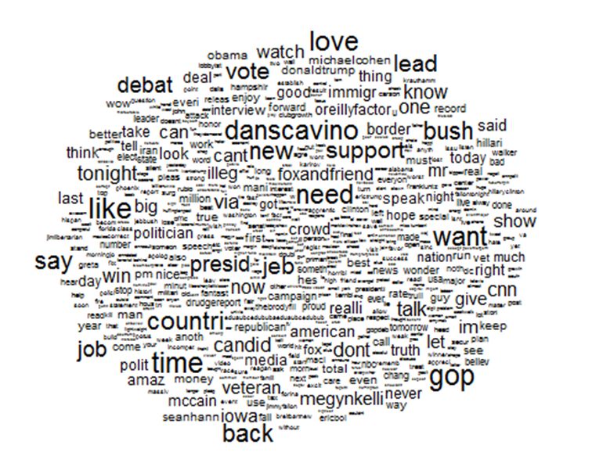
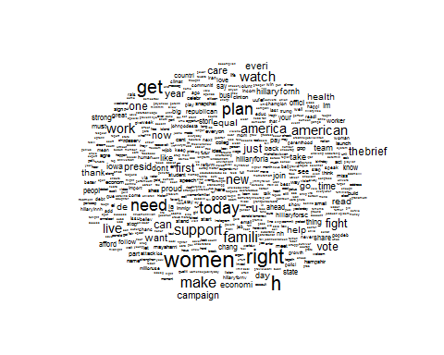
What were the prevailing narratives in each campaign?
Clinton:
Trump:
Insights
Word clouds work in a simple way: the more a specific word appears in a source of textual data the bigger and bolder it appears in the word cloud.
All tweets dating back to June 2015 (1,337 from Clinton’s and 1,456 from Trump) were consolidated into a corpus and then analyzed for frequence.
Clinton’s most used terms were: women, today, need, family
Trump’s most used terms were: danscavino, debate, gop, bush

Slide 5
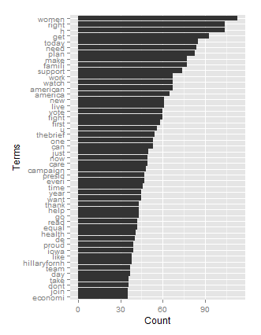
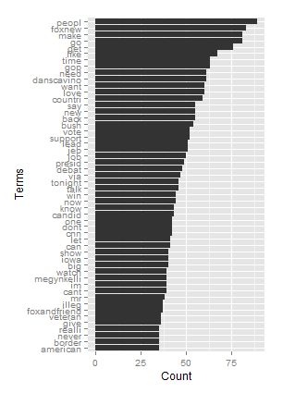
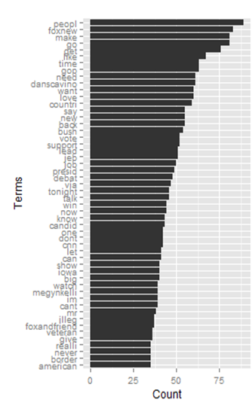
What were the candidates talking about?
Figure 3:Clinton
1
2
3
Insights
Clinton does not mention any of her competitors, Trump does
Trump’s total combined references to television networks (CNN, Fox News) would dwarf any other topic
Neither candidate mentions actual policy very much in their twitter feeds.
1
2
3

Slide 6
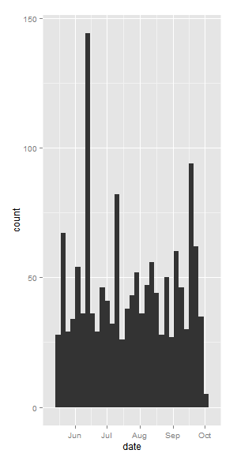
When was Clinton most active? Why?
From the New York Times
1
#1 Donald Trump announced his candidacy for President of the United States in the 2016 election at the Trump Tower in New York City with the slogan "Make America Great Again." More
Decline of Hillary Rodham Clinton's standing in polls, coupled with surprising strength of bid by Sen Bernie Sanders of Vermont, has some Democratic Party insiders beginning to consider casting about for a 'white-knight' contender as presidential race advances; proposed names include Vice Pres Joseph R Biden Jr, Sec of State John Kerry, Sen Elizabeth Warren and former Vice Pres Al Gore. MORE
1
2
2

Slide 7
Clustering Dendrogram

Slide 8
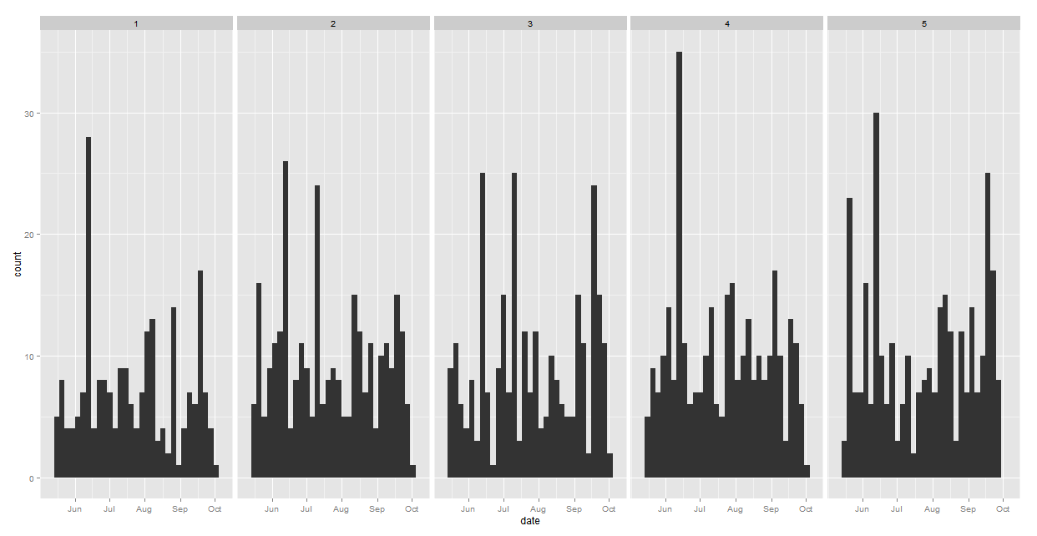
During those periods, what was Clinton talking about?
Method: k-means clustering. All tweets grouped by similar terms and topics
Topic 1: family, today, need, women, care
Topic 2: first, Hillary, Hillary Clinton, time
Topic 3: right, support, plan, fight
Topic 4: work, today, watch
Topic 5: right, make, live, need, now
When Trump announced his candidacy in June 2015, Clinton’s twitter feed focused on issues related to women and family and the fact that Clinton would
Topic 1:
Topic 2:
Topic 3:
Topic 4:
Topic 5:
1
1
2

Slide 9
Concluding Thoughts
NSAD has the capability to quickly access world-wide twitter feeds and build data sets geographically, temporally, or by user.
Methods exist to process and analyze the data beyond simple aggregations and averages
Visualization can assist sponsors interpret twitter data

